Slide 1

Fred & Harriett Taylor Memorial Library
Sexual Harassment Training

Slide 2
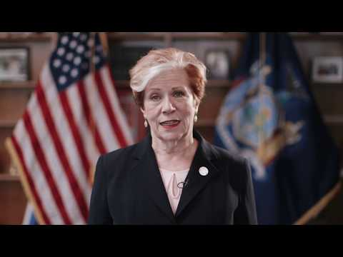
Please watch the NYS Sexual Harassment Prevention Training Video

Slide 3
In summary, sexual harassment is:
Sexual harassment is a form of sex discrimination and is unlawful under federal, state, and (where applicable) local law. Sexual harassment includes harassment on the basis of sex, sexual orientation, gender identity and the status of being transgender.
Sexual harassment is unlawful when it subjects an individual to inferior terms, conditions, or privileges of employment. Sexual harassment includes unwelcome conduct which is either of a sexual nature, or which is directed at an individual because of that individual’s sex when:
Such conduct has the purpose or effect of unreasonably interfering with an individual’s work performance or creating an intimidating, hostile or offensive work environment, even if the complaining individual is not the intended target of the sexual harassment;
Such conduct is made either explicitly or implicitly a term or condition of employment; or
Submission to or rejection of such conduct is used as the basis for employment decisions affecting an individual’s employment.
Under New York State law, harassment need not be “severe or pervasive” to be unlawful. Any of the harassing conduct described in this training can be unlawful unless it is shown to be no more than “petty slights or trivial inconveniences.”
Sexual Harassment Prevention Training | Page 8 | 10/19 Version

Slide 4
Two main types of sexual harassment
1: Hostile Environment: A hostile environment on the basis of sex may be created by any action previously described, in addition to unwanted words, signs, jokes, pranks, intimidation, physical actions or violence, either of a sexual nature or not of a sexual nature, directed at an individual because of that individual’s sex.
2: Quid Pro Quo Sexual Harassment: Quid pro quo sexual harassment occurs when a person in authority trades, or tries to trade, job benefits for sexual favors.
Sexual Harassment Prevention Training | Page 8 | 10/19 Version
Sexual Harassment Prevention Training | Page 9 | 10/19 Version

Slide 5
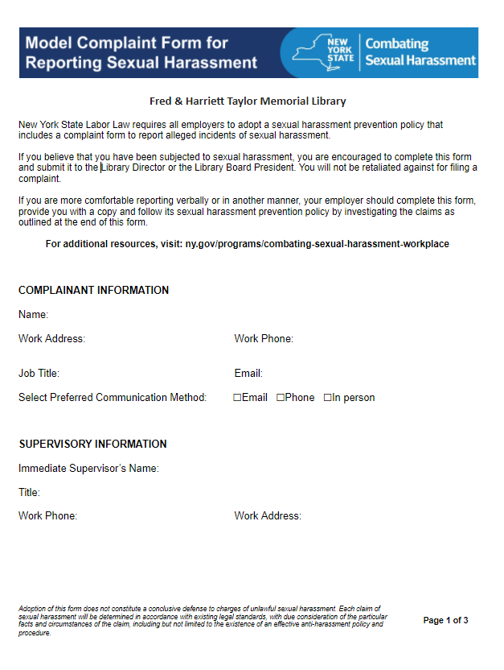
Complaint Form
If you believe that you have witnessed or have been subjected to sexual harassment, you may submit a written or verbal report to the Library Director or the Library Board President. An investigation will occur in a timely manner.
Complaint forms are located in the staff room.

Slide 6
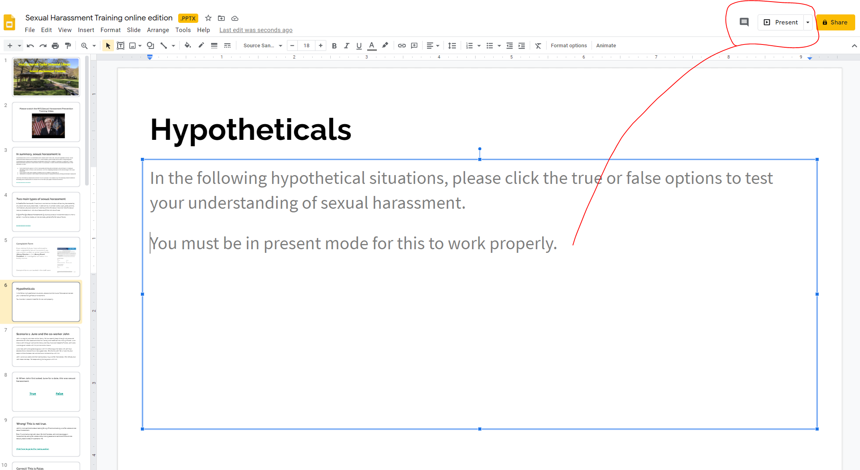
Hypotheticals
In the following hypothetical situations, please click the true or false options to test your understanding of sexual harassment.
You must be in “present mode” for this to work properly. See how below!

Slide 7
Scenario 1: June and the co-worker John
John is a regular volunteer at the library. He has recently been through a divorce and comments on a few occasions that he is lonely and needs to find a new girlfriend. June knows John through work at the library and they have even become friends. John asks June to go on a date with him, dinner and a movie.
June likes John and agrees to go out with him. She enjoys her date with John but decides that a relationship is not a good idea. She thanks John for a nice time, but explains that she does not want to have a relationship with him.
John waits two weeks and then starts pressuring June for more dates. She refuses, but John does not stop. He keeps asking her to go out with him.

Slide 8
Q: When John first asked June for a date, this was sexual harassment.
True False

Slide 9
Wrong! This is not true.
John’s initial comments about looking for a girlfriend and asking June for a date are not sexual harassment.
Even if June had turned John down for the first date, John did not engage in harassment by asking for a date and by making occasional comments that are not sexually explicit about his personal life.
Click here to go to the next question

Slide 10
Correct! This is False.
John’s initial comments about looking for a girlfriend and asking June for a date are not sexual harassment.
Even if June had turned John down for the first date, John did not engage in harassment by asking for a date and by making occasional comments that are not sexually explicit about his personal life.
Click here to go to the next question

Slide 11
Q: June can’t complain of harassment because she went on a date with Ralph.
True False

Slide 12
Wrong! This is false
Being friendly, going on a date, or even having a relationship with a co-worker does not mean that a co-worker has the right to behave as John did toward June.
She has to continue working with John and he must respect her wishes and not engage in behavior that has now become inappropriate for the workplace.
Click here to go to the next question

Slide 13
Correct! This is false.
Being friendly, going on a date, or even having a relationship with a co-worker does not mean that a co-worker has the right to behave as John did toward June.
She has to continue working with John and he must respect her wishes and not engage in behavior that has now become inappropriate for the workplace.
Click here to go to the next question

Slide 14
June complains to the Library Director, and the Library Director (as required), reports the complaint to the Library Board President.
John is questioned about his behavior and told to stop. He apologizes.
John stops for a while but then starts leaving gifts for June on the desk with love notes. The love notes are not overtly offensive, but Johns behavior is starting to make June nervous, as she is afraid he may start stalking her.
Q: John’s behavior with gifts/love notes is not harassment since he stopped asking for dates, as instructed.
True False

Slide 15
WRONG! POTENTIALLY FALSE:
John’s behavior may rise to the level of harassment, depending on the facts and circumstances.
June should report John’s behavior in accordance with the library policy in order that the library may have an opportunity to assist her in getting John to stop his behavior and take corrective action.
Because John has returned to bothering June after being told to stop, he could be subject to disciplinary action for his behavior, up to and including termination.
Click here to go to the next question

Slide 16
POTENTIALLY FALSE:
John’s behavior may rise to the level of harassment, depending on the facts and circumstances.
June should report John’s behavior in accordance with the library policy in order that the library may have an opportunity to assist her in getting John to stop his behavior and take corrective action.
Because John has returned to bothering June after being told to stop, he could be subject to disciplinary action for his behavior, up to and including termination.
Click here to go to the next question

Slide 17
Scenario 2: Stella and missing books
Stella does not like to check out books for patrons that go against her beliefs. Stella has started taking books off the shelves that refer to a homosexual lifestyle or that contain a lot of sexual content and has been putting them in a box in the basement. When she does so, she makes a comment in front of the other workers showing her disapproval. A patron comes to the front desk and is looking for a book, one of the books that should be there but are not. Stella says, “why would anyone want to check that book out? It should not even be on our shelves. I cannot believe that you would want to read that, you are not going to the other side are you? You are going to have to ask someone else to help you find that book.”
Q: Is Stella engaging in sexual harassment?
Yes No

Slide 18
Correct! Yes
She is engaging in sex discrimination by refusing to help the patron . Her actions also create a hostile work environment for others who may feel intimidated by her comments and actions.
Click here to go to the next question

Slide 19
Wrong!
She is engaging in sex discrimination by refusing to help the patron . Her actions also create a hostile work environment for others who may feel intimidated by her comments and actions.
Click here to go to the next question

Slide 20
Scenario 3: Gary and Carrie
Gary works as volunteer for the Library. He likes to wear jewelry, and his attire frequently includes earrings and necklaces.
The library director, Carrie, think’s that it is “weird” that as a man, Gary wears jewelry and wants to work at the library. She frequently makes sarcastic comments to him about his appearance and refers to him “jokingly” as her office boy.
Gary, who hopes to further his career in the library setting, as he has a degree in Library Science, applies for a promotional position that would make him a paid employee and involve more work at the front desk and out in the community.
Carrie tells Gary that if he wants the promotion, he had better look “more normal” or else wait for a different position not so involved with the public.

Slide 21
Q: Gary’s boss is correct to tell him wearing jewelry is inappropriate for work with the public.
True False

Slide 22
Wrong! This is false
Gary’s jewelry is only an issue because Carrie considers it unusual for a man to wear such jewelry.
Therefore, her comments to Gary constitute sex stereotyping
Click here to go to the next question

Slide 23
Correct! This is false
Gary’s jewelry is only an issue because Carrie considers it unusual for a man to wear such jewelry.
Therefore, her comments to Gary constitute sex stereotyping
Click here to go to the next question

Slide 24
Carrie is also “suspicious” that Leonard is gay, which she says she “doesn’t mind” but she thinks Leonard is “secretitive.”
She starts asking him questions about this private life, such as “Are you married?” “Do you have a partner?” “Do you have kids?”
Gary tries to respond politely “no” to all her questions but is becoming annoyed.
Carrie starts gossiping with Gary’s coworkers about his supposed sexual orientation.
Q: Gary is the recipient of harassment on the basis of sex and sexual orientation.
True False

Slide 25
Correct! Potentially True
It may constitute harassment on the basis of sex due to his failure to adhere to Carrie’s sex stereotypes
Carrie’s conduct may also constitute harassment on the basis of his perceived sexual orientation. It does not matter whether or not Gary is, in fact gay, in order for him to have a claim for sexual orientation harassment.
Gary might also be considered a victim of harassment on the basis of gender identity, which is a form of sex and/or disability discrimination prohibited by the Human Rights Law. Gary should report Carrie’s conduct, which is clearly a violation of library policy.
Click here to go to the next question

Slide 26
Wrong! This is potentially true
It may constitute harassment on the basis of sex due to his failure to adhere to Carrie’s sex stereotypes
Carrie’s conduct may also constitute harassment on the basis of his perceived sexual orientation. It does not matter whether or not Gary is, in fact gay, in order for him to have a claim for sexual orientation harassment.
Gary might also be considered a victim of harassment on the basis of gender identity, which is a form of sex and/or disability discrimination prohibited by the Human Rights Law. Gary should report Carrie’s conduct, which is clearly a violation of library policy.
Click here to go to the next question

Slide 27
Gary decides that he is not going to get a fair chance at the new promotion under these circumstances, and he complains to the Library Board President about Carrie’s behavior.
The Board President does an investigation and tells Carrie that Gary’s jewelry is not in violation of any workplace rule, that she is to consider him for the position without regard for his gender, and that she must stop making harassing comments, asking Gary intrusive questions, and gossiping about his personal life.
Carrie stops her comments, questions, and gossiping, but she then recommends a woman to be promoted to the open position.
The woman promoted has much less experience that Gary and is lacking a degree in Library Science .
Q: Gary has likely been the victim of discrimination on the basis of sex, sexual orientation and/or retaliation.
True False

Slide 28
It Depends...
We don’t know Carrie’s reason for not recommending Gary for the job or whether she has legitimate business reasons.
Gary should speak with the Board President, in order that the circumstances of the promotion may be investigated.
If it is found that Carrie abused her supervisory authority by failing to consider Gary for the promotion, she should be subject to appropriate corrective action.
Click here to finish the training!

Slide 29
Should you have any questions pertaining to the scenarios or other content within the training, please call the Fred & Harriett Taylor Memorial Library and leave your name and phone number. Someone will be in contact with you shortly to address your question(s).
Please make sure you fill out your training verification form and send back to Directory Murphy!

Slide 30
Have a safe and great year!
All training materials and information within this training are granted from NYS Combating Sexual Harassment in the Workplace.
https://www.ny.gov/programs/combating-sexual-harassment-workplace

